Slide 1
Notes:
Items in bold donate that they have been included in the use case specifications.

Slide 2
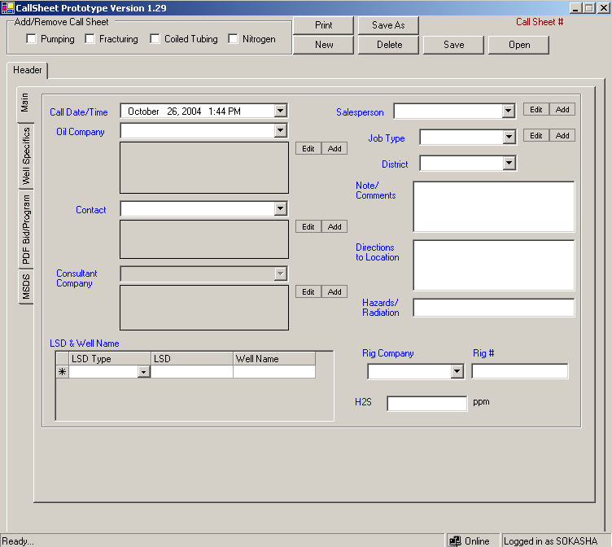
The first time the Client calls about a Job
Accounting Schema
From Conway's Sales DB, to be part of local DB
We also need Fax, Email, and Phone for the contact. We can have two type of contact field and Calgary, we need to input both.
If a Consultant Company is selected, the consultant company address should overwrite the oil company address.
Add new field here, it’s a drop down and named Programmer, it is a single Sanjel employee name, can be multiple
The print function should print the Call Sheet, selected MSDS, and any uploaded Bid/Programs, that’s if they selected to print MSDS and Bid/program, by default, it should only print just the call sheet
From Accounting DB, for both USA and Canada, to be part of local DB, depending on what is selected here, the Call Sheet will be a US or Canada Call Sheet
Add: H2S Present yes/no, if yes then get the H2S %
1% = 10000 ppm

Slide 3
The selection of the Service Line Section needs to happen very early(using the UI) to min min the number of job types
CAN BE MULTIPLE.
Add Sanjel Technical Contact: Name and Cell. Can be multiple
See JobType.xls
This drop down list will get populated depending on the what service line this call sheet for. For example, if it’s a Fracturing call sheet, only Fracturing job type should be in the drop down list. Build the gui in the way where selected the service section happens before selected the job type
Do spell check
Depending on the LSD Type selected from the LSD Type column, the format in the LSD column should be enforced. See Shahram for details, no specific format for the GPS coordinates, as long as we capture it in a text box. ONLY ONE LSD PER CALL SHEET, define a LSD control here, that all can use, we also need a field for GPS coordinates. The LSD parts need to be divided when stored.
Get it from Drop down list and be able to add and edit. , CAN BE MULTIPLE.
Add: is it a Critical Well, yes no
If yes, pop a window with some question, like the once in the coiled tubing section

Slide 4
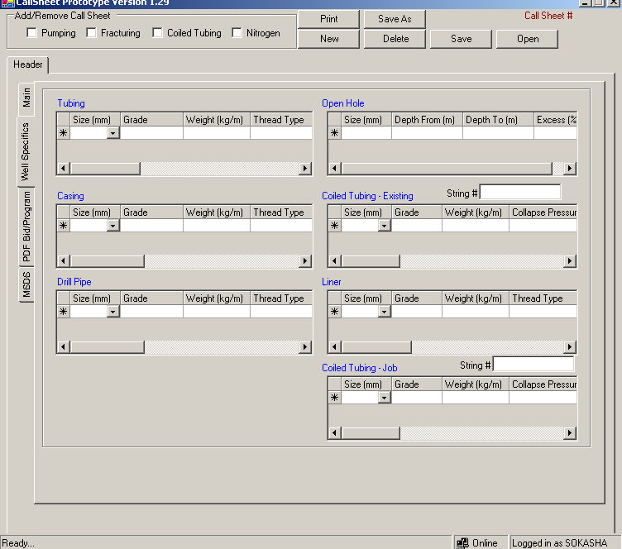
All the Well Specifics will be populated from the Data Hand Book, to be in the local DB
The number of decimals for all here should be the same as the data hand book. We nee to keep in mind that the units will be different depending on the country.
A string that can have both letters and numbers

Slide 5
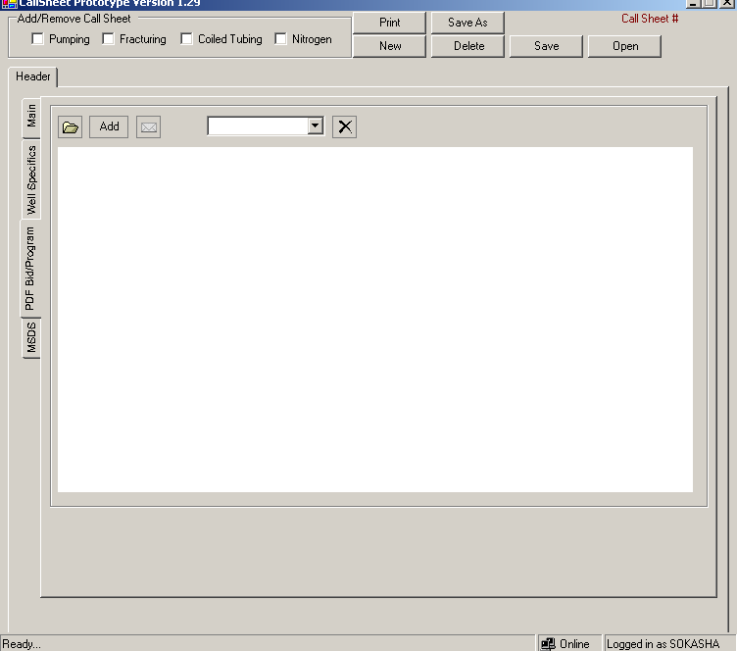
Will start an email and attach the attachment as PDF to it
Remember the last browsed to folder location
Only email to @Sanjel for now
Only PDF files can be uploaded
Thy should be able to print only the attachment
For each file we will show, Who attached it, when, and description(which they will add)
An easy interface, maybe one button to it all
Here they want to see who else has this call sheet open

Slide 6
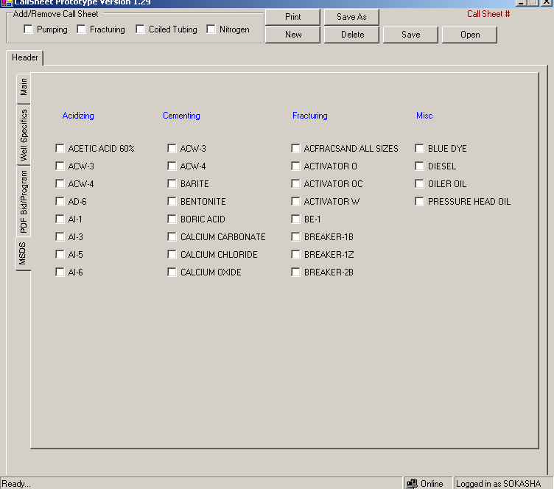
The MSDS selecting in this Tab will be printed with the Call Sheet
In the Admin Tool, they should be able to add a new MSDS and upload its PDF file, also overwrite and existing PDF.
S:\Sanjel Intranet\Sanjel Intranet\Engineering\MSDS_PDFs
IDEA: too look at the chemicals on the call sheet and the system logically select the MSDS in not so important.
see O:\Files\MSDS where O=Public on 'Edmon01‘
See O:\Files\MSDS \MSDS Intranet Listing.xls

Slide 7
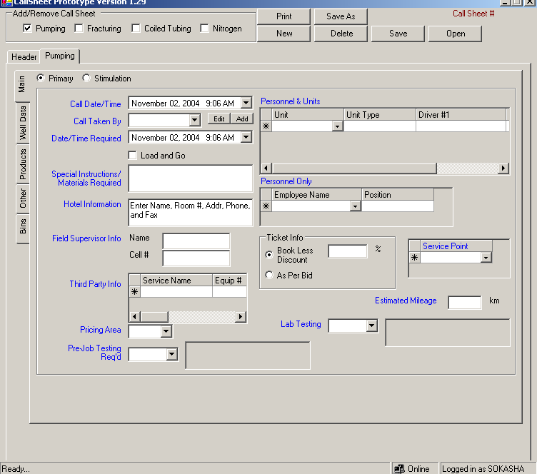
By default the current day
The user of this workstation. They don’t need to select it
Change to Date/Time Requested:
If this is checked, the Date Time Required = current time and date.
Should be a drop down with a list of all Field Supervisors. Van be more than one, cab be Add or Edit
From Price Book DB
Testing that happen on the job location before we start the job
This is testing that happens before the Job, in the Lab. If yes, then what kind, we need to get a list of what kind of testing we offer at the tech center
See Testing.xls
From the Employee table, or from our Admin DB. The employee job title not bonus position
From Price Book DB and it cannot be multiple
This form is the same for all Service Lines sections

Slide 8
Change to Remedial/Stimulation
Change to Personnel
Can do spell check
Change to km, or mileage in the US
Change to Units. No table contains all of this info, some can be populated from the Accounting DB. We can also use the new Fab Shop DB. Need to also capture where is the Unite coming from. Change from Personnel & Units to Units. Driver1 and Driver2 should be drop down from the employee table. And whatever is selected here should be added to the Personnel Only Grid
This form is the same for all Service Lines sections

Slide 9
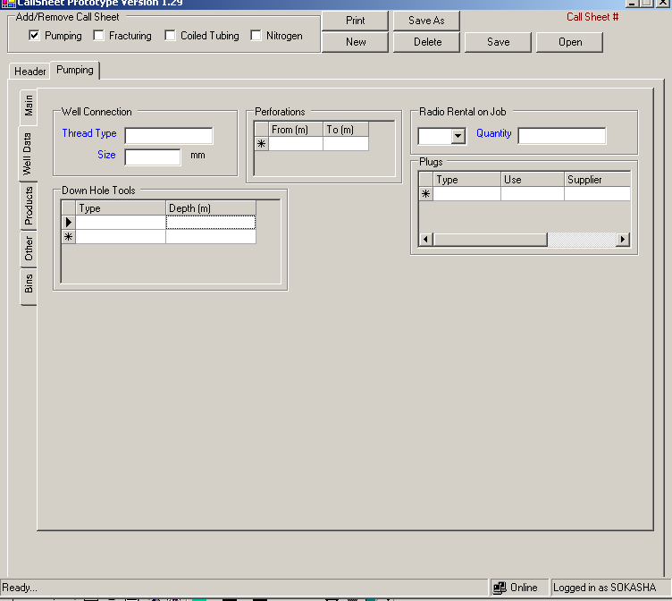
Change to: Treatment Interval
And for each interval we have: From, To, and Formation
Can be multiples
Can be added to this drop down from the Admin Tool. *1 its in page 17 in the price book
We have 3 kinds of plugs: cement Plugs, Cementing Plugs and Mechanical Plugs. We need to add From and To in (m) Do not worry about this at this point, it needs to be finalized once we have the Service report prototype finalized, they are both the same idea.

Slide 10
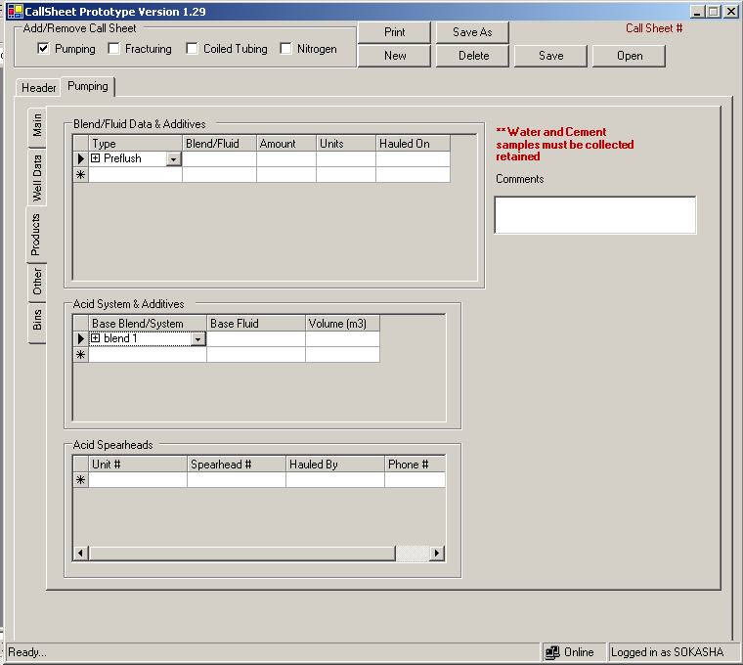
The order should be Blend/Fluid then Type. And from the Additives come out of the Blend/Fluid not the Type.
Get the Cement Blends and Additives from the Canadian or US price book, depending the Call Sheet country.
Change title to Acid Type & Additives
See Acids Systems.xls
Remove it, not needed for this service line
Add: Was extra cement required by customer ?Yes/No
To be printed on the Call Sheet in BIG

Slide 11
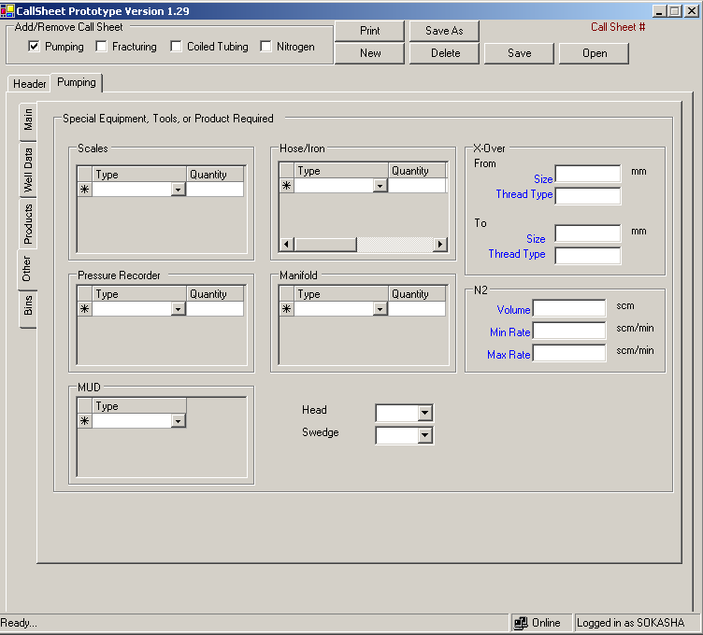
Add column source
Can be added to this drop down from the Admin Tool. *1
Need: Type, Viscosity,Desity,Weight, Yield Point, Temperature, and Recorded @
Change to Plug loading Head, and if yes, then select Regular or Top Drive and size. Can be multiple, so use a grid.
Need size. Can be multiple, so use a grid.
X-Over section can be multiple, need a grid layout. Also the units need to be drop down

Slide 12
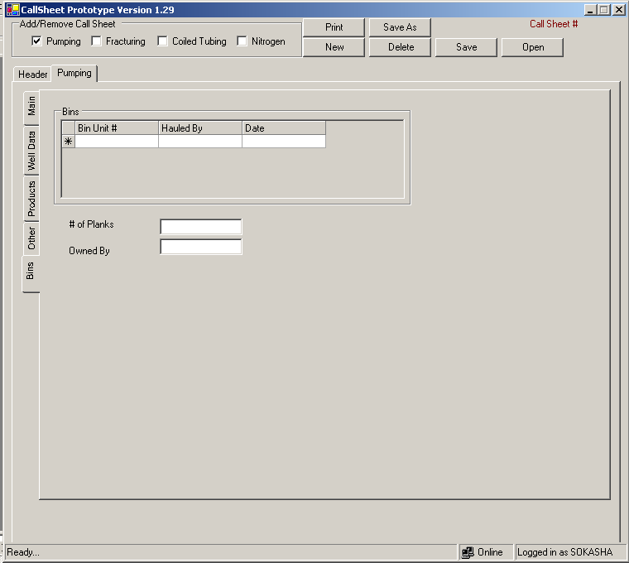
Rig Tracker DB
Add new column: Cartrege Hual, see price book, page 10, code 1489
Take theses two out and only ask the following questions: What is the number of Sanjel’s Planks required?
Add:
Bottom Hole Static Temperature and its Time and date in hh:mm
Bottom Hole Circulating Temperature and its Time and date in hh:mm
Bottom Hole login Temperature and its Time and data in hh:mm

Slide 13
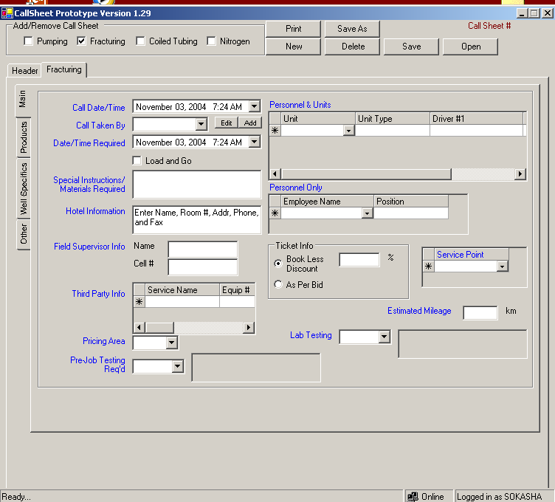
SEE PUMPING MAIN

Slide 14
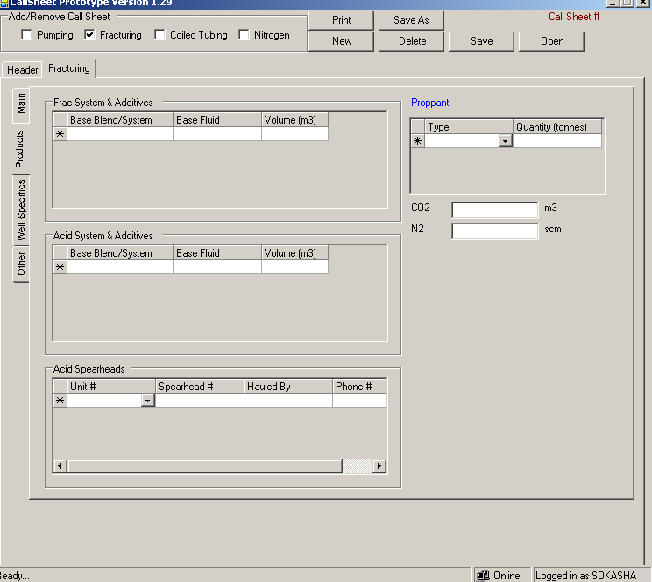
FracturingAndAcidBlends.xls
Add one more column, Acid %
Change to Co2 Volume in m3, co2 rate in m3/m, n2 volume in scm, n2 rate in scm/m, and finally Total fluid Rate in m3/m
Can be added to this drop down from the Admin Tool. *1 in the price book
Need to get the list

Slide 15
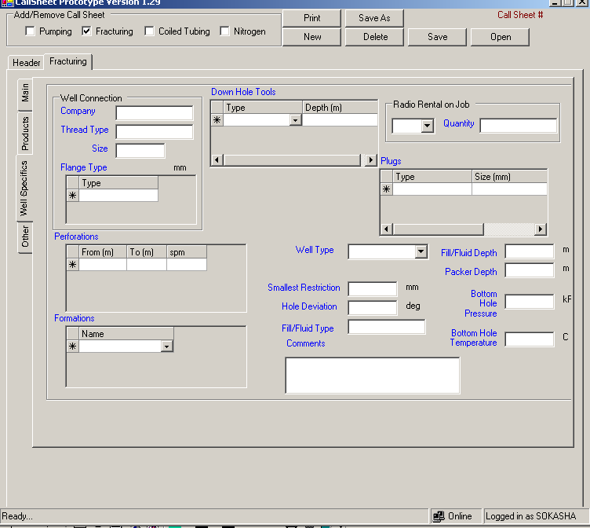
Drop down and edit and add, can be multiple, put in a grid layout maybe, with the following columns: Type, Company, Thread Type, and Size
See Completion Profiles Flanges.xls Can be multiple
Change from m to (mMD) and add new column: TVD. Combine the Perforation and Formation in a table with the following column: from, to, spm, TVD, formation, Hole deviation
Formations.xls
Here add Pumping Mode: and it can be Tubing, Casing, Annulus, Manifold
ALSO add Porosity and it is a number% AND Saturation of Water and it is a number%
Change to Total Hole Deviation
Packer in both here and Down Hole Tools, So remove it from here and add: Bulged Back Total Depth in m

Slide 16
Can be more than on, so grid maybe
Can be added to this drop down from the Admin Tool. *1 ALSO ADD Bridge Plug
ALSO remove to coil/Well specs
Need to get the list

Slide 17
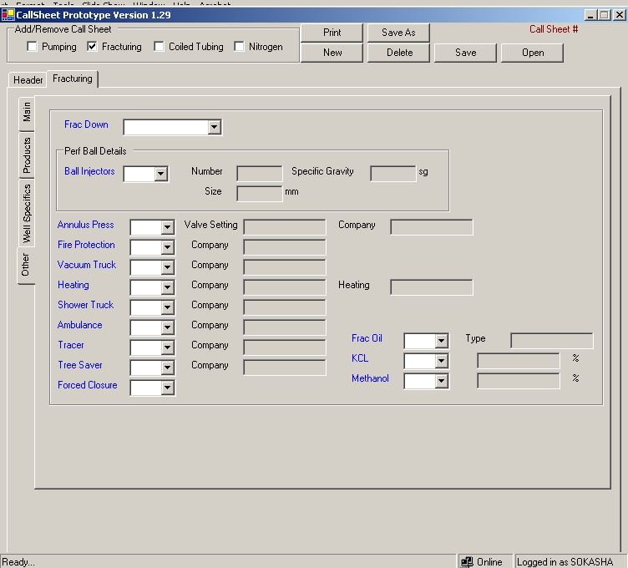
ADD:
Fracturing Gradient in kPa/m, can we have multiples?
Permeability in mD, can we have multiples?
Porosity in %, can it be multiple?
Water Saturation in %, can it be multiple?
Estimated Horse Power:
For fluid in kW
For Co2 in kW
For N2 in kW
Can be added to this drop down from the Admin Tool. *1

Slide 18
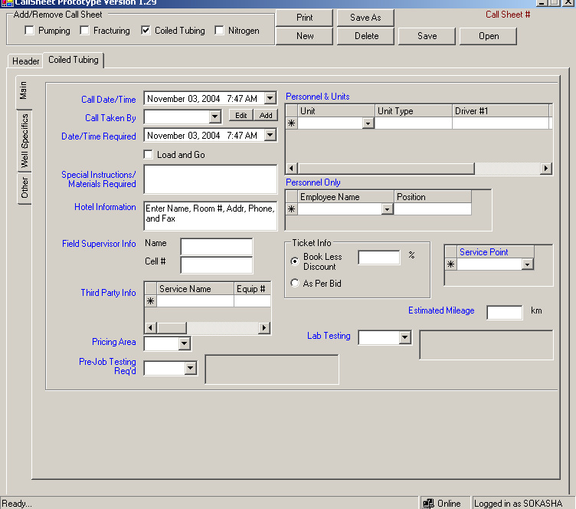
SEE PUMPING MAIN

Slide 19
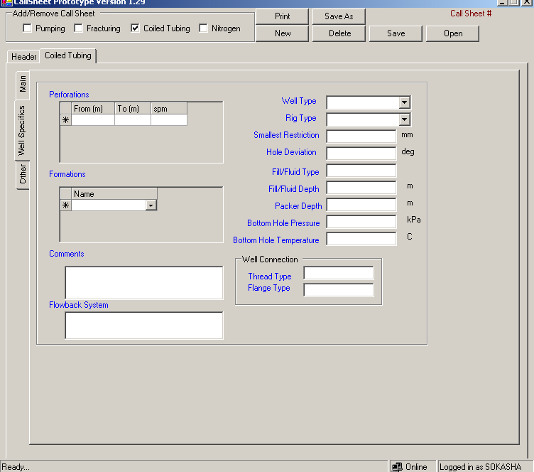
Can be added to this drop down from the Admin Tool. *1
Formations.xls
Change from m to (mMD) and add new column: TVD. Combine the Perforation and Formation in a table with the following column: from, to, spm, TVD, formation, Hole deviation
Both Fill/Fluid Type and Fill/Fluid Depth can be multiple and text box, so maybe a grid layout. Every Fill/Fluid Type has a Depth. NOTE that these field are in other forms too.
ADD
Bottom Hole Flowing Pressure in Mpa
Linear Production Index in ???
Gas Flow Rate in ???
Liquid Flow Rate in ???
Bulged Back Total Depth in m
Kick-Off Point in m
Both Thread Type and Flange Type can be multiple and text box, so maybe a grid layout for each. NOTE that these field are in other forms too
Maybe a grid layout with the following columns:
Type: can be only two Flange or Thread
If Flange then pressure and size(r.Rx)
If Thread then Type and size.
Do spell check

Slide 20
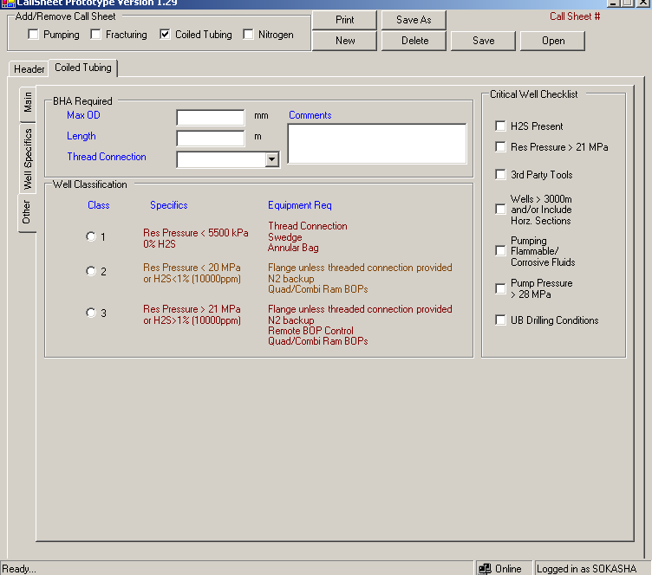
Thread Connection can be multiple and text box NOTE that this field is in other forms too.
Can be added to this drop down from the Admin Tool. *1
Change:
1 to less than or equal to 5500
2 to less than or equal to 21
3 to grater than 21
Whatever checked needs to be printed

Slide 21
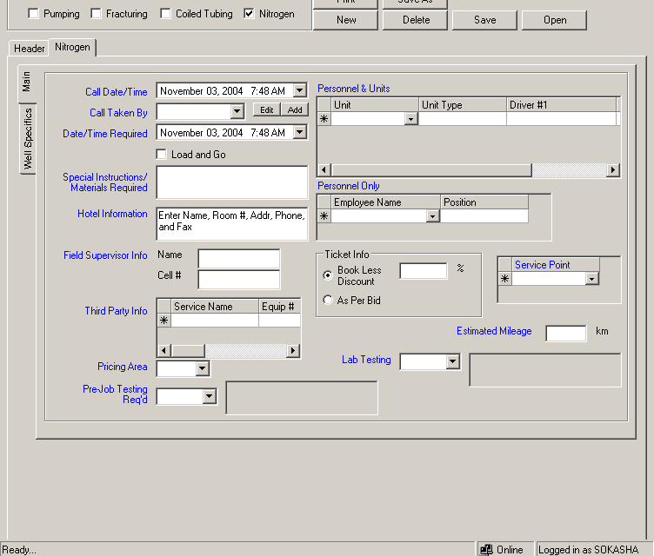
SEE PUMPING MAIN

Slide 22
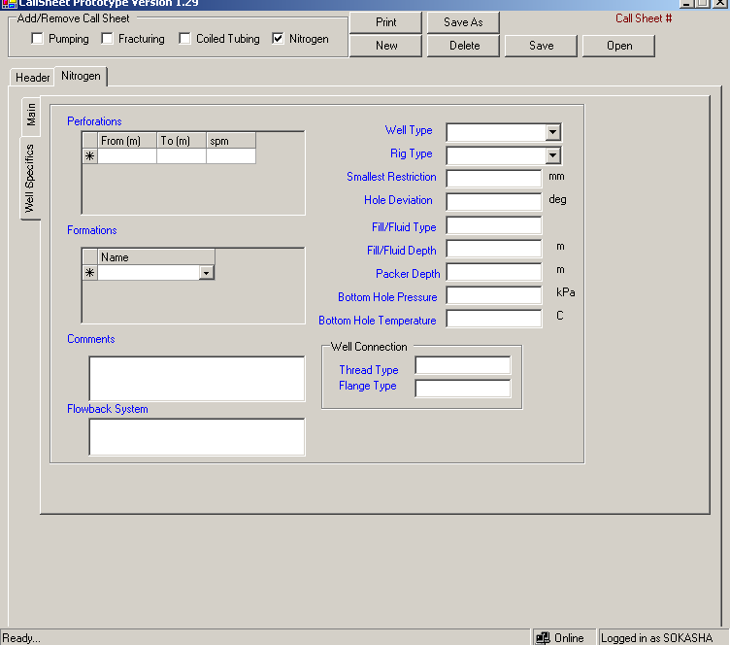
Formations.xls
Can be added to this drop down from the Admin Tool. *1

